Slide 1
Internet Security 101: From Packets to Propaganda
Nick Feamster Princeton University

Slide 2
A Brief History of the Internet
ARPAnet
Conceived in 1966/67 to connect big academic computers together.
First operational ARPAnet nodes in 1969
UCLA, SRI, UCSB, Utah
NPLnet
Around the same time, at the National Physical Laboratory in UK.
Around 20 US Arpanet nodes by 1971
First host-to-host protocol.
Two cross-country links - all at 50 Kbps

Slide 3
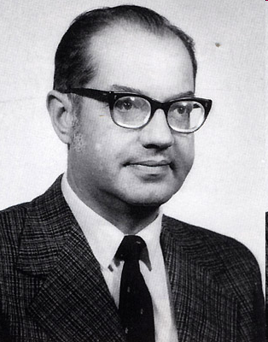
Paul Baran
Inventor of packet-switched networks
Born April 29, 1926
Undergraduate at Drexel, Masters at UCLA
Work at RAND
Founded Metricom (metro-area networks)

Slide 4
Biographical/Research Notes
Going to UCLA to work with Estrin was somewhat accidental
Note how Baran started working on the problem of survivable networks
He had already convinced himself that survivable networks is/was a problem
Figured out how to fit his beliefs about important problems into RAND’s mission

Slide 5
“On Distributed Communications Networks”
Two types of networks: centralized and distributed
Centralized network is vulnerable
Destruction of a small number of nodes can destroy communication
Need to make the network “as distributed as possible”

Slide 6
Figures of Each Type of Network

Slide 7
Defining Connectivity
Nodes are said to be connected if, after some fraction of nodes and links
Analysis involves the ability of an adversary to bisect a network given the successful probability of attack on nodes/links

Slide 8
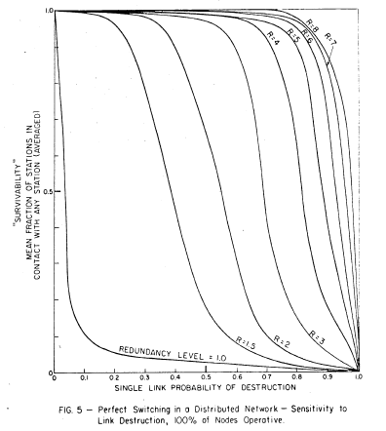
Reliability

Slide 9
Origins of Packet Switching
Conventional systems try only a small subset of potential paths
What if, instead, the communications system could try a larger percentage of paths?
Goal: Building reliable systems out of unreliable components at lowest cost

Slide 10
Idea: Message Blocks (“Packets”)
No centralized routing mechanism
Analogy to postman sorting mail

Slide 11
ARPAnet plan Rough sketch by Larry Roberts, late 1960s.

Slide 12
International Networking
First proposed to link NPLnet and ARPAnet in 1971.
Use link through UK to seismic array in Norway.
Politics made this impossible.
UCL connected in July 1973, via a link to Norway, and onward satellite link to ARPAnet.

Slide 13
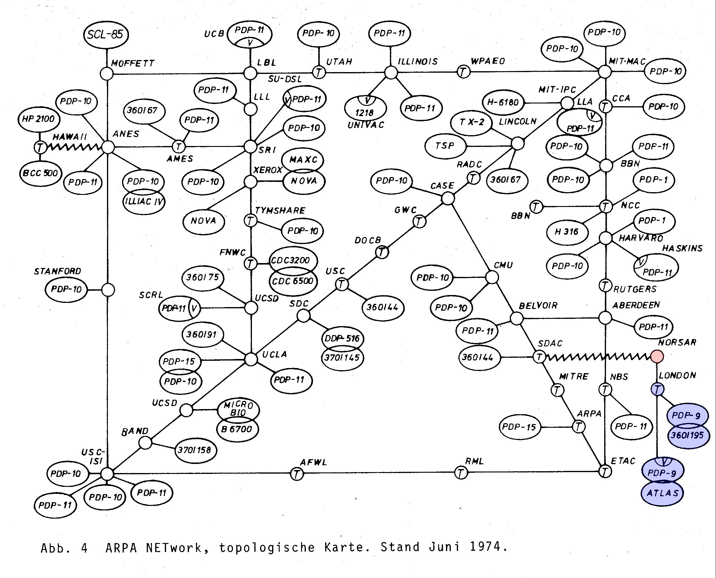

Slide 14
Towards an Internet
ARPAnet wasn’t the only network.
SATNET over satellite.
Packet Radio networking.
Ethernet Local Area Networks.
Work started in 1973 on replacing the original Network Control Protocol with TCP and IP:
IP: Inter-network Protocol
TCP: Transmission Control Protocol.

Slide 15
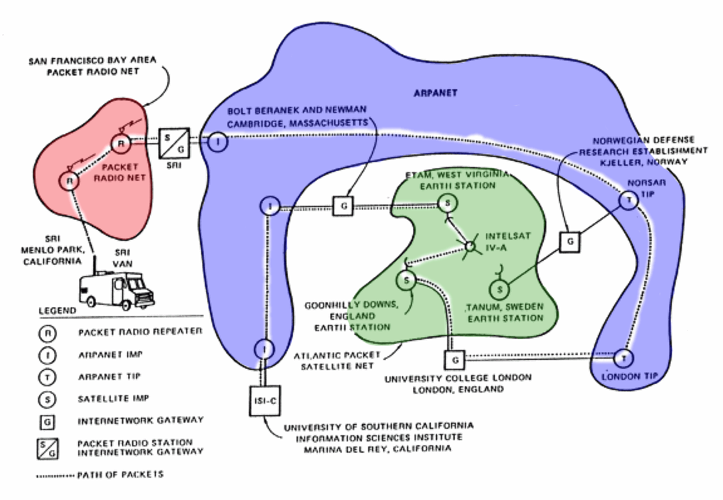
Inter-networks Demonstration, 1977

Slide 16
The Design Goals of Internet, v1
Interconnection/Multiplexing (packet switching)
Resilience/Survivability (fate sharing)
Heterogeneity
Different types of services
Different types of networks
Distributed management
Cost effectiveness
Ease of attachment
Accountability
Decreasing Priority
“This set of goals might seem to be nothing more than a checklist of all the desirable network features. It is important to understand that these goals are in order of importance, and an entirely different network architecture would result if the order were changed.”
These goals were prioritized for a military network. Should priorities change as the network evolves?

Slide 17
Interconnection Pre-1995
Network interconnection in the U.S. has evolved significantly since the early days of the Internet.
Notes:
The initial form of the Internet was a single, wide area or backbone network (the Internet equivalent of a long-distance provider) that was operated by the U.S. government.
Smaller, regional networks connected to this network forming a simple hierarchical structure.
Traffic from one part of the Internet to another was handed off to this backbone network, which carried it to the destination network.
For many years, the technical requirements on the routing protocol providing this function were simple, and there was no need to deal with business issues.

Slide 18
Interconnection Circa 1995
The backbone eventually transitioned from a single government-operated backbone to a federated backbone model comprised of multiple commercial network operators.
Notes:
As a result of the commercial transition, the routing protocol responsible for maintaining the map of destination networks required improvement.
A new routing protocol, called Border Gateway Protocol (BGP), was created, allowing for commercial provision of backbone connectivity by multiple parties.
BGP allowed network operators to manage this more complex and competitive space, and to express at least a limited set of business constraints on routing.
For example, using BGP a network operator could specify how it preferred traffic flow into and out of its network. At the time of this report, BGP remains the standard routing protocol used to exchange information about IP routing between networks.

Slide 19
Interconnection Today
Interconnection today has evolved into a complex amalgam of models incorporating new connectivity options, delivery options, traffic management requirements and business practices. (“Flattening” of the hierarchy.)
Notes:
The diagram shows the “flatter,” highly interconnected Internet of today.

Slide 20
IPv4 Addresses: Networks of Networks
Topological Addressing
32-bit number in “dotted-quad” notation
www.cs.princeton.edu --- 128.112.136.35
128
112
136
35
10000000
01110000
10001000
00100011
Network (16 bits)
Host (16 bits)
Problem: 2³² addresses is a lot of table entries
Solution: Routing based on network and host
130.207.0.0/16 is a 16-bit prefix with 2¹⁶ IP addresses

Slide 21
HTTP Basics (Overview)
HTTP over bidirectional byte stream (e.g., TCP)
Interaction
Client looks up host (DNS)
Client sends request to server
Server responds with data or error
Requests/responses are encoded in text
Stateless
HTTP maintains no info about past client requests
HTTP “Cookies” allow server to identify client and associate requests into a client session
Notes:
Why TCP?
- don’t want to have holes in our web page – won’t render correctly
Encoded in text would be “human readable”
Stateless – simplifies the server, reduces resources / client

Slide 22
What is a Content Distribution Network?
A CDN is an overlay network, designed to deliver content from the optimal location
In many cases, optimal does not mean geographically closest
CDNs are made of distinct, geographically disparate groups of servers, with each group able to serve all content on the CDN
Servers may be separated by type
E.g. One group may serve Windows Streaming Media, another group may serve HTTP
Servers are not typically shared between media types

Slide 23
What is a Content Distribution Network
Some CDNs are network-owned (Level 3, Limelight, AT&T), some are not (Akamai, Mirror Image, CacheFly, Panther Express)
Network-owned CDNs have all / most of their servers in their own ASN
Non-network CDNs can place servers directly in other ASNs
This means things like IPFIX will not be useful for determining traffic to/from non-network CDNs

Slide 24
Content Distribution Network
origin server
in North America
Proactive content replication
Content provider (e.g., CNN) contracts with a CDN
CDN replicates the content
On many servers spread throughout the Internet
Updating the replicas
Updates pushed to replicas when the content changes
CDN distribution node
CDN server
in S. America
CDN server
in Asia
CDN server
in Europe

Slide 25
Cybersecurity: Denial of Service

Slide 26
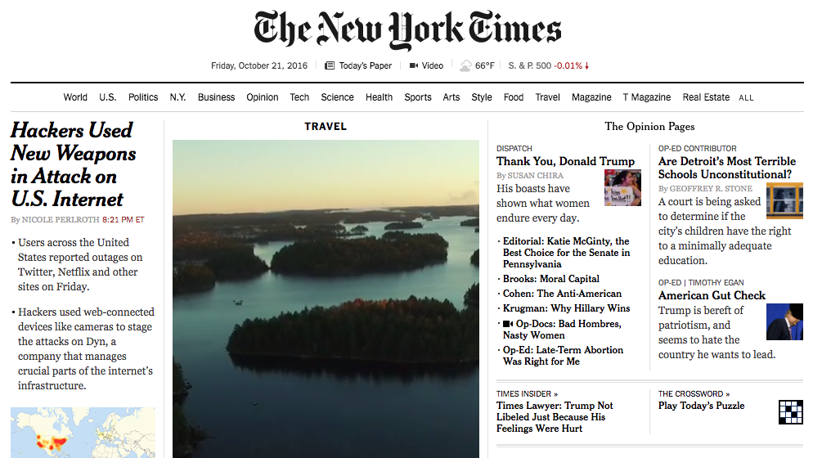

Slide 27
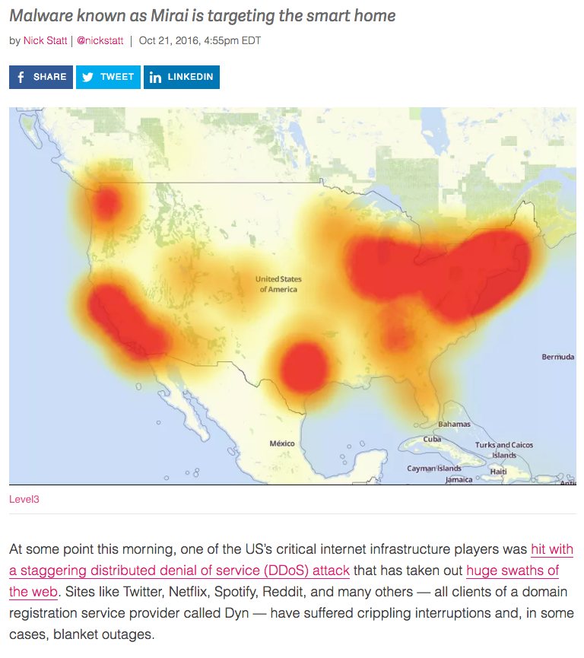
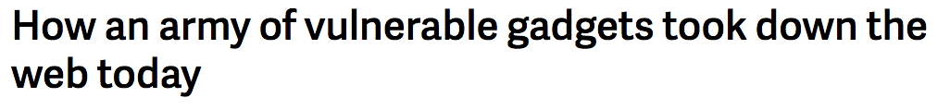
Threat du Jour: IoT-Based Botnets

Slide 28
Mirai DDoS Post-Mortem
“During a DDoS which uses the DNS protocol it can be difficult to distinguish legitimate traffic from attack traffic. For example, the impact of the attack generated a storm of legitimate retry activity as recursive servers attempted to refresh their caches, creating 10-20X normal traffic volume across a large number of IP addresses. When DNS traffic congestion occurs, legitimate retries can further contribute to traffic volume.
We saw both attack and legitimate traffic coming from millions of IPs across all geographies. It appears the malicious attacks were sourced from at least one botnet, with the retry storm providing a false indicator of a significantly larger set of endpoints than we now know it to be. We are still working on analyzing the data but the estimate at the time of this report is up to 100,000 malicious endpoints. We are able to confirm that a significant volume of attack traffic originated from Mirai-based botnets.

Slide 29
Attack on Availability
Destroy hardware (cutting fiber) or software
Modify software in a subtle way (alias commands)
Corrupt packets in transit
Blatant denial of service (DoS):
Crashing the server
Overwhelm the server (use up its resource)
A
B

Slide 30
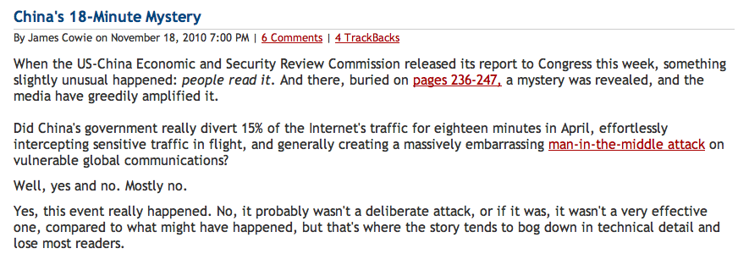
Routing: China’s Accidental Hijack

Slide 31
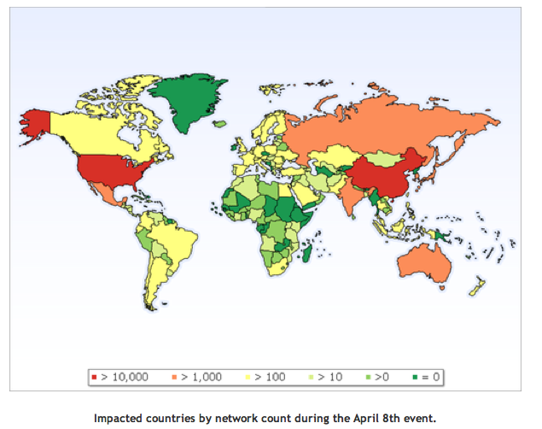
China Hijack: Sequence of Events
On April 8, 2010, China advertised about 50,000 blocks of IP addresses from 170 different countries
60,000 prefixes from the US
Event lasted for 20 minutes
Why did most people not notice?
How might more traffic have been intercepted?
http://www.renesys.com/blog/2010/11/chinas-18-minute-mystery.shtml

Slide 32
Other “Famous” Hijack Events
February 24, 2008: Pakistan advertises a small part of YouTube’s AS 36561
Likely as a botched attempt to block YouTube in Pakistan, following a government order
January 22, 2006: Con Edison (AS 27605) mistakenly advertises lot of networks (Level 3, UUNet, Panix ISP, …)
April 25, 1995: AS 7007 incident
“Ultimately, though, the problem remains on of transitive trust. A provider can and should limit the advertisements it will accept from a customer.”

Slide 33
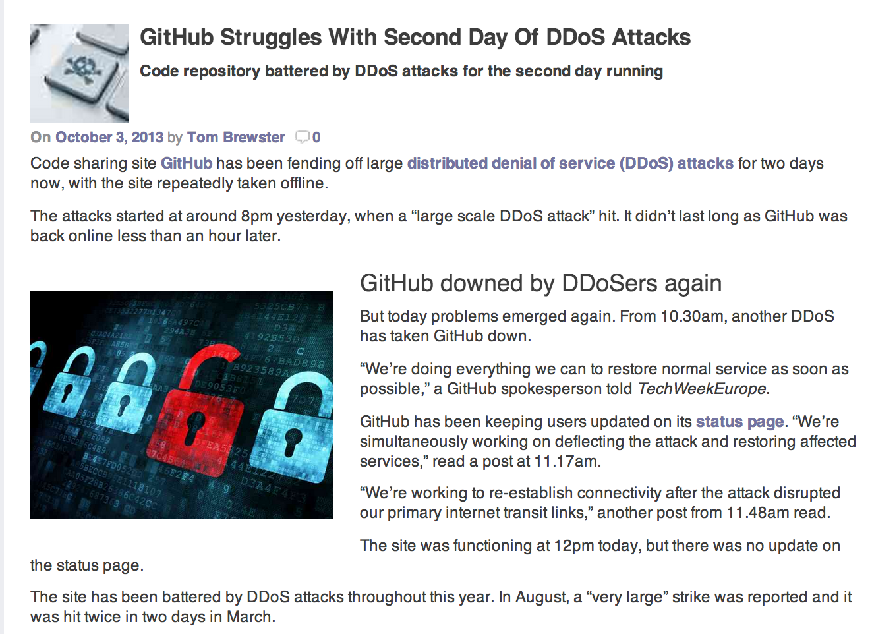
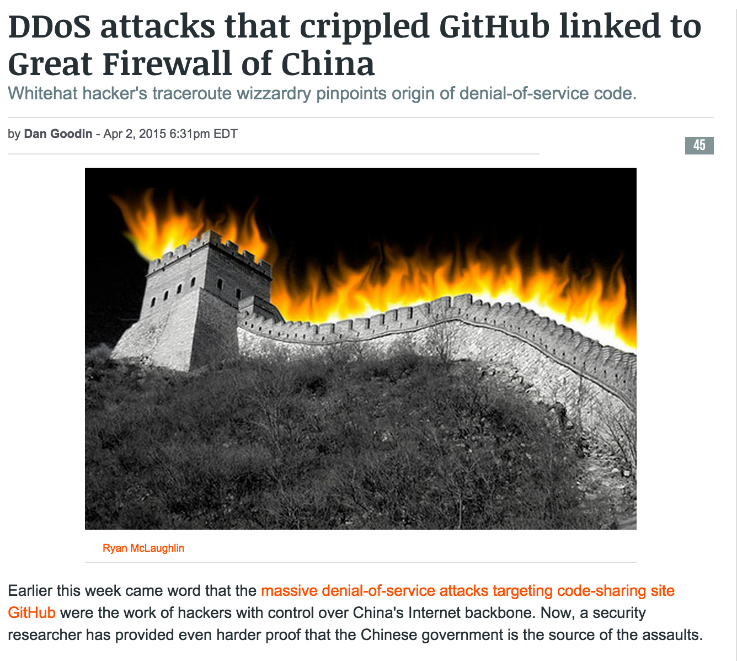
Denial of Service

Slide 34
Denial of Service: What is it?
Attacker
Victim
Attempt to exhaust resources
Network: Bandwidth
Transport: TCP connections
Application: Server resources
Typically high-rate attacks, but not always

Slide 35
Early Denial of Service
DoS Tools
Single-source, single target tools
IP source address spoofing
Packet amplification (e.g., smurf)
Deployment
Widespread scanning and exploitation via scripted tools
Hand-installed tools and toolkits on compromised hosts (unix)
Use
Hand executed on source host

Slide 36
Censorship and Circumvention

Slide 37
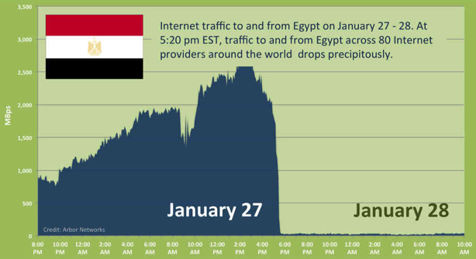
Notes:
2011

Slide 38
An “Old” Problem
Many governments/companies trying to limit their citizens’ access to information
Censorship (prevent access)
Punishment (deter access)
Surveillance (spy on or monitor access)
China, Saudi Arabia, many companies
How can we defeat such attempts?
Circumvent censorship
Undetectably

Slide 39
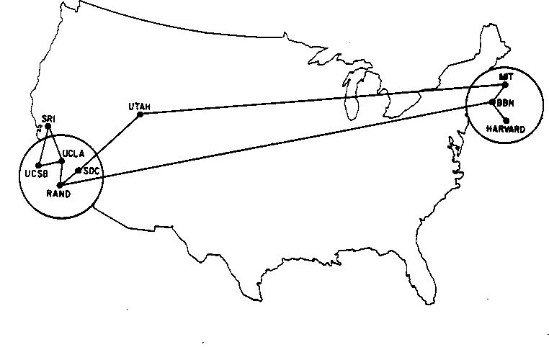
In the Beginning…
Network of trusted research universities
Few stakeholders (and no profits)
No security concerns
One government
Survivability
Reliability
Performance
Heterogeneity
Distributed Management
Heart, F., McKenzie, A., McQuillian, J., and Walden, D., ARPANET Completion Report, Bolt, Beranek and Newman, Burlington, MA, January 4, 1978.

Slide 40
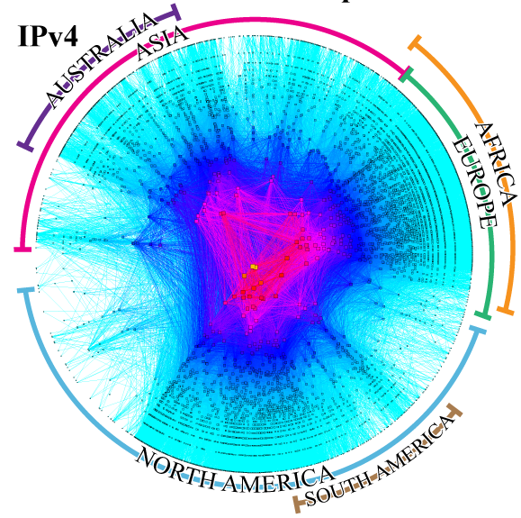
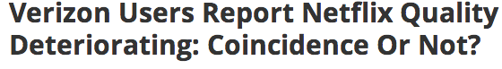
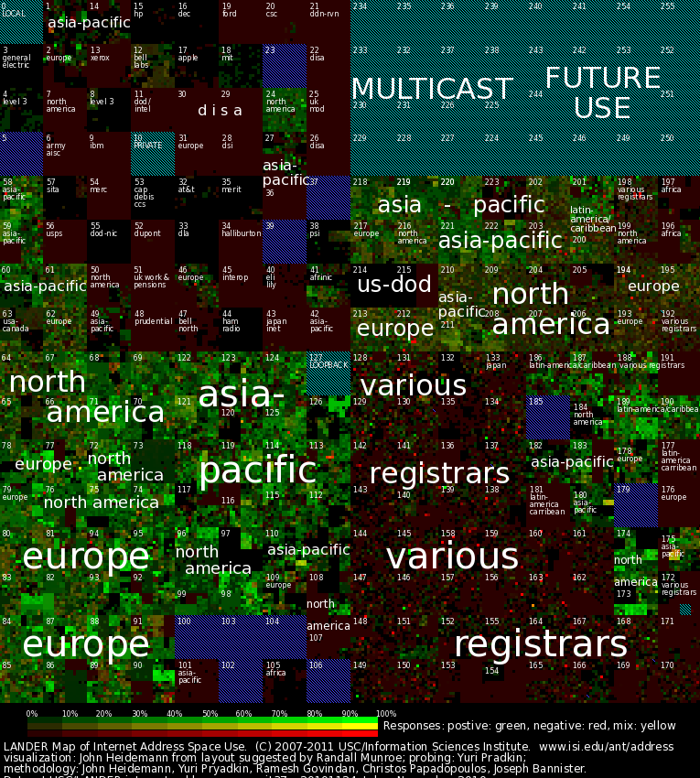
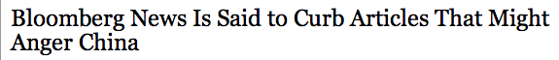
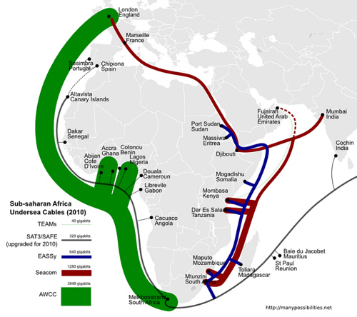
Today
ISPs and Content Providers
Attackers and Miscreants
Networking Meets Users
Economics
Policy
Security
Privacy
HCI
Machine Learning
ICTD
…
Governments and Dissidents
Sources: CAIDA Archipelago Project (2013), manypossibilities.net (2013), ISI Census of the Internet Address Space (2010)

Slide 41
Protocols are Not Enough!
“Early Days”: Purely technical solutions could guarantee good end-to-end performance.
Now: Internet experience depends on many other factors:
Economics (affects who connects to whom)
Policy (affects who controls resources)
Security (affects whether users are “safe”)
Psychology (affects how users perceive performance)
Interfaces (affects what users see, and when)

Slide 42
Internet Censorship is Widespread
Practiced in 59 countries around the world
Many western countries
Several electoral democracies (e.g., S. Korea, Turkey) have significant censorship
YouTube blocked in Turkey for two years
Many North Korean sites blocked in South Korea
Twelve countries have centralized infrastructure for monitoring/blocking
Source: Open Network Initiative

Slide 43
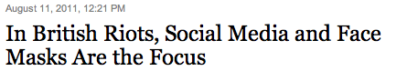

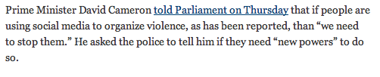
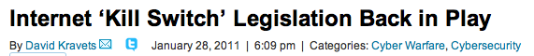


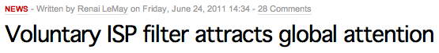
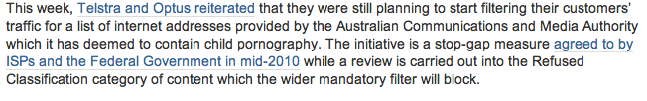
Why do Countries Censor?
Political stability
National security
Social values

Slide 44



Conventional Internet Censorship
Censor
Censor
Firewall
Alice
Block Traffic
Bob
Censored net
Uncensored net
Punish User
Notes:
“Ok so now I’m going to give you a brief primer on Internet censorship and some existing approaches taken to overcome it.”
“Suppose Alice wants to get some content from Bob. If she accesses the Internet from behind a censorship firewall then the censor may monitor or block communication with Bob, and may even punish Alice for trying to communicate with Bob.”

Slide 45
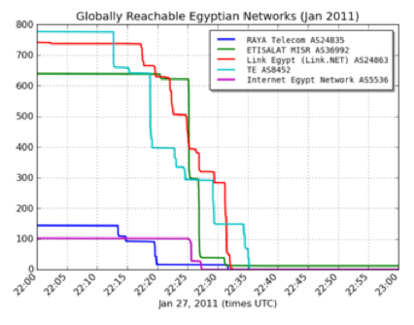
Example: One Type of Censorship
ISP acts on instructions from a judge, government official, etc.
Filtering: IP address, DNS
Keyword-based: search for keyword in URL
China, Iran, Tunisia have such systems in place
Common: Use of centralized infrastructure (e.g., routing)
Source: Renesys

Slide 46
Questions
Why do countries censor?
How widespread is Internet censorship?
How do countries enforce censorship?
How might a government (or organization) exercise control over its citizens?
What can citizens and users do about it?
What are the trends in censorship and circumvention?

Slide 47
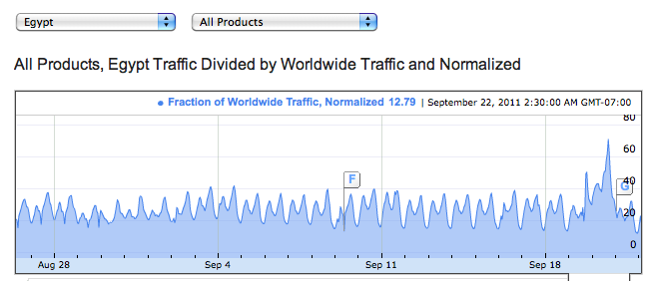
Monitoring Censorship
Herdict: Crowdsourcing reports of Internet censorship
Google Transparency Report: Monitor reachability of online services

Slide 48



Circumvention Tools
Community wireless networks
Anonymous routing schemes
Distributed services

Slide 49
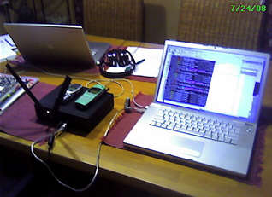
BYOI (Bring Your Own Internet)
Commotion Wireless
OpenBTS (open cell stations)
Open wireless PBX with standard handsets

Slide 50
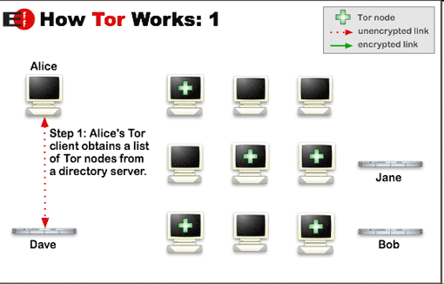
Anonymous Routing: Tor
Notes:
[ Do demonstration of Tor with envelopes/messages. ]

Slide 51
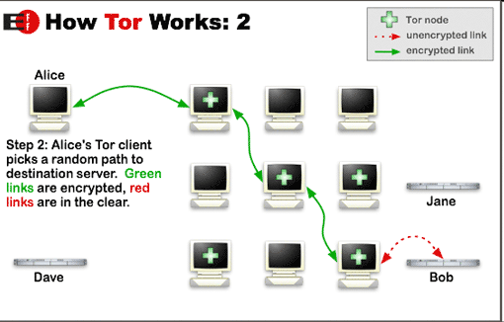
Anonymous Routing: Tor

Slide 52
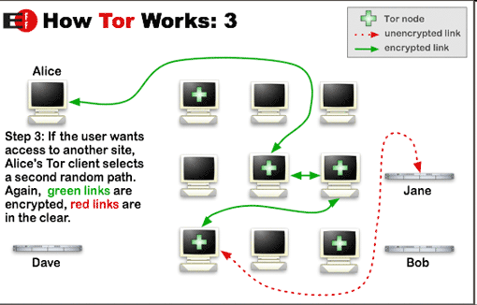
Anonymous Routing: Tor
Notes:
[ Give a demo of Tor. ]

Slide 53
Filter Bubbles

Slide 54

Notes:
May 2011

Slide 55





Personalization as “Filter Bubble”
“A squirrel dying in front of your house may be more relevant to your interests right now than people dying in Africa.”
– Mark Zuckerberg
Online personalization is creating situations where we only see things that already suit our own tastes.
Personalization can also be exploited.

Slide 56
Motivation
Search engines deliver inconsistent search results
These inconsistent results may sway searchers’ opinions or judgment to products or political events etc.
Notes:
Over the past few years, the personalized search technique is largely deployed on different search engines.
It incorporates a user’s individual information, tailors user’s search experience, and presents inconsistent search results to different users. However, …

Slide 57




Pollution Attack
Pollution attack targets recommender systems:
Personalized search
Video & product recommendation
Intelligent ad network
Input
Recommendation
algorithms
Output
Notes:
This attack targets intelligent systems like personalized search, video recommendation, and intelligent ad networks.
It attacks the input of these systems.

Slide 58








Pollution Attack
pollution attack
Most relevant
content
Bob
False content
Fake Browsing behaviors
Browsing behaviors
Database
User computer
Preference profile
Recommender system
Notes:
Before I talk about this attack, let’s quickly look at how these intelligent systems work.
First, these intelligent systems take a user’s browsing behaviors as input, and create a preference profile…..
As I just said this attack targets the input of intelligent system. And, here the input is the browsing behavior.
So, the attack picture becomes more clear. … first, the attacker use some fake browsing behaviors to pollute the preference profile. Because intelligent system uses the preference profile to make decision, the intelligent system will pick the false content and return it to the user.

Slide 59

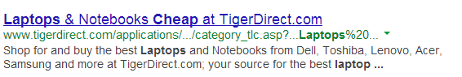
Pollution Attack on Search Engine
Rank 1st
Rank 6th
Notes:
The pollution attack can be used for many purposes.
First, it can be used for business promotion.
Assume I am selling “laptops” on my website and I would like to increase the visibility of my website. So I want it rank on the top on Google because higher rank can bring me a large number of visitors.

Slide 60
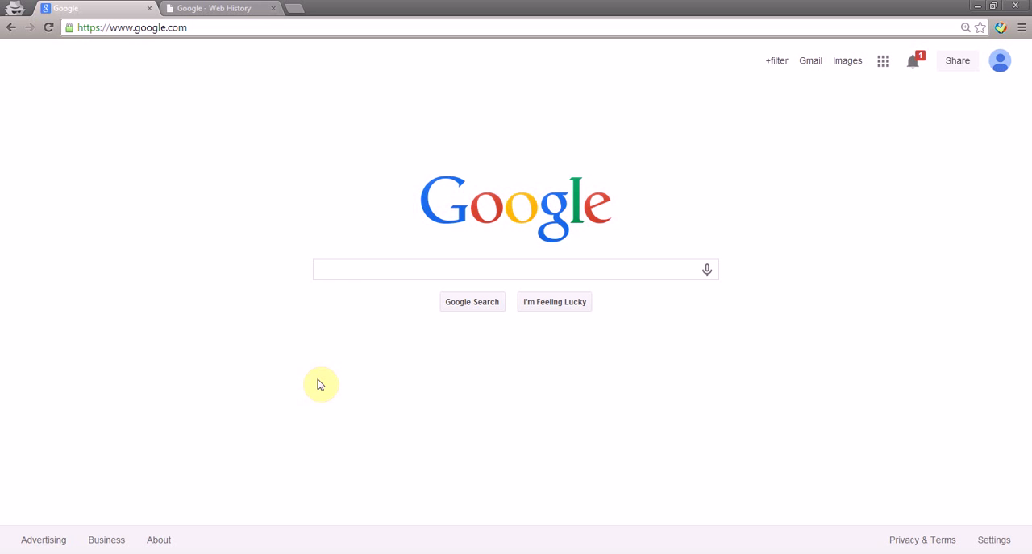
Pollution Attacks
Take This Personally: Pollution Attacks on Personalized Services. X. Xing, W. Ming, D. Doozan, A. Snoeren, N. Feamster, W. Lee. In USENIX Security Symposium, 2013.

